Slide 1
KNOWLEDGE REPRESENTATION USING SEMANTIC NET

Slide 2
Semantic Network
Devised by Quillian in 1968, as a model of human memory.
The technique offered the possibility that computers might be made to use words in something like the way humans did, following the failure of early machine-translators.
Organisation of semantic nets:
knowledge is represented as a collection of concepts, represented by nodes (shown as boxes in the diagram), connected together by relationships, represented by arcs (shown as arrows in the diagram).

Slide 3
Nodes and Arcs
Arcs define binary relationships that hold between objects denoted by the nodes.
mother
age
Sue
john
5
age
wife
father
husband
mother(john,sue)
age(john,5)
wife(sue,max)
age(max,34)
...
34
Max
age

Slide 4
Semantic Network
In a semantic network, the knowledge is represented by a directed graph.
Nodes represent Objects
•In each node, a concept is defined by
–Concept (object) name;
–Attributes; and
–Attribute values.
•An edge defines the relation between two concepts.
Links or Arcs represent Relationships
“instance of” - set membership
“is a” - inheritance
“ has a” - attribute descriptors
“part of” - aggregation

Slide 5
Is a
Has a
Part-of
Instance of

Slide 6
Classes, Objects, Attributes, Values - Object Orientation
Classes describe common properties of objects
Objects may be physical or conceptual
Attributes are characteristics of objects
Values are specific measures of Attributes for specific instances

Slide 8
An IS-A Hierarchy

Slide 9
An IS-PART Hierarchy

Slide 10
Representing Events and Language
Semantic networks are also very good at representing events, and simple declarative sentences, by basing them round an “event node”.
In fact, several of the earliest semantic networks were English-understanding programs.

Slide 12
Example Semantic Network
A semantic network that defined the propertied of snow and ice
The concept snowman inherits all the properties of snow
The concept of ice and snow share a number of properties

Slide 13
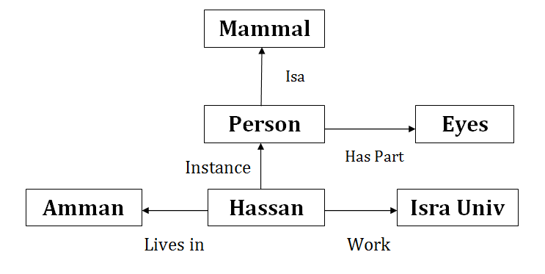
Expressing Relationship in Semantic Networks
The most important link in a semantic network is the is-a link
A semantic network can organize knowledge in a hierarchy by using the is-a link such that the lower nodes inherit the properties of the higher nodes

Slide 14
The is-a relationship in a semantic networks
In a semantic network information about a superclass is made available to subclasses through the is-a link
The is-a link allows the lower nodes to inherit properties of the connect upper nodes

Slide 15
The is-a relationship in a semantic networks

Slide 16
The is-a relationship in a semantic networks
By tracing the semantic network an AI program can answer question :
Q : Does a canary has wings?
A : Yes
Q : Does a shark breathe?
A : Yes
Q : Does a bird move?
A : Yes
Q : Does a bird swim?
A : No
Q : Can a salmon sing?
A : No
Q : Is shark similar to a canary?
A : No

Slide 17
Relating two entities using semantic network
Semantic network for the fact “the height of ali is 72 inches’
A semantic network to relate two entities ali and ahmad by the fact “Ali is taller than Ahmad”
The nodes H1 and H2 are new concepts representing Ali’s and Ahmad’s heights, respectively

Slide 18
Inference in semantic networks.
The inference procedure in semantic nets is called inheritance, and it allows one node’s characteristics to be duplicated by a descendent node.
Example: Consider a class “aircraft”, and assume that “balloons”, “propeller-driven objects” and “jets” are subclasses of it, i.e.
“Balloons are A-KIND-OF aircrafts”
“Propeller-driven objects are A-KIND-OF aircrafts”, etc.
Assume that the following attributes are assigned to aircrafts: “Aircraft IS-A flying object”, “Aircraft HAS-A wings”, “Aircraft HAS-A engines”
All properties assigned to the superclass, “aircraft”, will be inherited by its subclasses, unless there is an “exception” link capturing a non-monotonic inference relation.

Slide 19
Object-attribute-value triplets
One problem with semantic nets is that there is no standard definition of link names. To avoid this ambiguity, we can restrict this formalism to a very simple kind of a semantic network, which has only two types of links, “HAS-A” and “IS-A”. Such a formalism is called Object-Attribute-Value (OAV) triplets, and it is a widely used mode of knowledge representation (especially for representing declarative knowledge). It is also the base of the Semantic Web KR model, called RDF.
Example: Consider object “airplane”. Some of its attributes are:
number of engines;
type of engines;
type of wing design.
Possible values of these attributes are:
number of engines: 2, 3, 4.
type of engines: jet, propeller-driven.
type of wing design: conventional, swept-back.

Slide 20
Object-attribute-value triples (example contd)
Object Attribute Value
Airplane NumberOfEngines 2
Airplane NumberOfEngines 3
Airplane NumberOfEngines 4
Airplane TypeOfEngines Jet
Airplane TypeOfEngines Propeller
Airplane TypeOfWings Conventional
Airplane TypeOfWings SweptBack
Or, as predicates
NumberOfEngines (Airplane, 2), …
TypeOfEngines (Airline, Jet), …
TypeOfWings (Airlines, Propeller), …

Slide 23
Semantic Network for Animals

Slide 24
Semantic Networks as Knowledge Representations
Using Semantic Networks for representing knowledge has particular advantages:
1. They allow us to structure the knowledge to reflect the structure of that part of the world which is being represented.
2. The semantics, i.e. real world meanings, are clearly identifiable.
3. There are very powerful representational possibilities as a result of “is a” and “is a part of” inheritance hierarchies.
4. They can accommodate a hierarchy of default values (for example, we can assume the height of an adult male to be 178cm, but if we know he is a baseball player we should take it to be 195cm).
5. They can be used to represent events and natural language sentences. Clearly, the notion of a semantic network is extremely general. However, that can be a problem, unless we are clear about the syntax and semantics in each case.

Slide 25
Advantages of Semantic nets
Easy to visualize
Formal definitions of semantic networks have been developed.
Related knowledge is easily clustered.
Efficient in space requirements
Objects represented only once
Relationships handled by pointers

Slide 26
Disadvantages of Semantic nets
Inheritance (particularly from multiple sources and when exceptions in inheritance are wanted) can cause problems.
Facts placed inappropriately cause problems.
No standards about node and arc values

Slide 27
Semantic Nets Advantages Disadvantages
Flexible
easy to understand
support inheritance
“natural” way to represent knowledge
Hard to deal with exceptions
procedural knowledge difficult to represent
no standards for defining nodes or relationships

Slide 28
Problems with semantic nets and OAV triplets
There is no standard definition of link and node names. This makes it difficult to understand the network, and whether or not it is designed in a consistent manner.
Inheritance is a combinatorially explosive search, especially if the response to a query is negative. Plus, it is the only inference mechanism built in semantic nets, which may be insufficient for some applications.
Initially, semantic nets were proposed as a model of human associative memory (Quinllian, 1968). But, are they an adequate model? It is believed that human brain contains about 10^10 neurons, and 10^15 links. Consider how long it takes for a human to answer “NO” to a query “Are there trees on the moon?” Obviously, humans process information in a very different way, not as suggested by the proponents of semantic networks.
Semantic nets are logically and heuristically very weak. Statements such as “Some books are more interesting than others”, “No book is available on this subject”, “If a fiction book is requested, do not consider books on history, health and mathematics” cannot be represented in a semantic network.

